Slide 1

AI1601 – OSG201
BIOMETRICS
Group Seven

Slide 2

01.
Introduction to authentication
Phan Viet Thuan Thien
02.
Biometrics systems
Nguyen Tan Loc
CONTENT
03.
Pros & Cons
Nguyen Son Tung
04.
Real world application
Tran Thanh Duong

Slide 3
PART 01
Introduction to authentication
Speaker: Nguyễn Việt Thuận Thiên

Slide 4

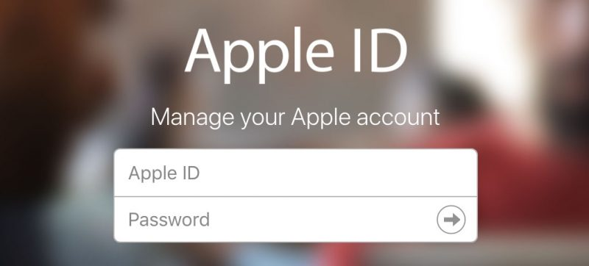
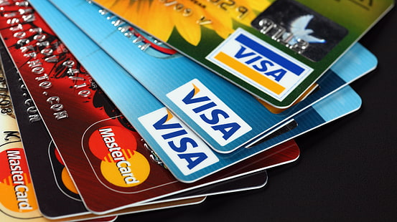
01.
Introduction to authentication
ID
Username
Password
Passcode
1. Knowledge: Something the user knows.
2. Possession: Something the user has.
3. Inherence: Something the user is.
Cards
Invitations
Identification vs Authentication
Notes:
the process or action of verifying the identity of a user or process.
https://authy.com/what-is-2fa/
Google auth
https://security.stackexchange.com/questions/35157/how-does-google-authenticator-work#:~:text=Google%20Authenticator%20supports%20both%20the,for%20generating%20one%2Dtime%20passwords.&text=Whenever%20a%20password%20is%20generated,HOTP%20with%20one%20major%20difference.

Slide 5
01.
Authentication vs Identification
Identification
Authentication
It determines the identity of the person.
It determines the identity of the person.
It determines whether the person is indeed who he claims to be.
It determines whether the person is indeed who he claims to be.
No identity claim
Many-to-one mapping.
Cost of computation ∝ number of record of users.
Identity claim from the user
One-to-one mapping.
The cost of computation is independent of the number of records of users.
Captured biometric signatures come from a set of known biometric feature stored in the system.
Captured biometric signatures may be unknown to the system.
Notes:
What is biometrics

Slide 6
01.
Introduction to Biometrics
Bios (Life) - Metrikos (Measure).
No human involvement.
Comparison takes place in Real-Time.
Notes:
What is biometrics

Slide 7
01.
Types of biometrics
Face
Finger Print
Hand
Iris
DNA
Physiological
Key Stroke
Signature
Voice
Behavioral
Notes:
What is biometrics

Slide 8
01.
Why biometrics
Passwords are not reliable
Can be stolen/forgotten/shared
Easy to guess
PINs are also not reliable
Can be duplicated
Can be Lost or stolen
Notes:
What is biometrics

Slide 9
PART 02
Biometrics systems
Speaker: Nguyễn Tấn Lộc
Notes:
https://www.csoonline.com/article/3339565/what-is-biometrics-and-why-collecting-biometric-data-is-risky.html#:~:text=Biometrics%20are%20physical%20or%20behavioral,patterns%2C%20voice%20or%20typing%20cadence.

Slide 10
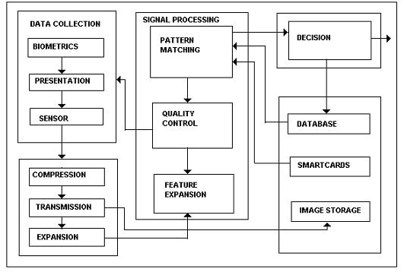
02.
Biometrics systems example
Notes:
What is biometrics

Slide 11
02.
Verificaiton systems
Claimed identity
System
Database
System
Database
Login
Interface
Login
Interface
Feature
Extractor
Feature
Extractor
Matcher
Matcher
One template
Get Name & Snapshot
Extract Features
One match
True / False
Verification
Notes:
What is biometrics

Slide 12
02.
Identifycation systems
System
Database
System
Database
Login
Interface
Feature
Extractor
Matcher
Login
Interface
Feature
Extractor
Matcher
N templates
Extract Features
N templates
Get Name & Snapshot
Extract Features
N match
N match
User’s identity or
“user unidentified”
User’s identity or
“user unidentified”
Identification
Identification
Notes:
What is biometrics

Slide 13
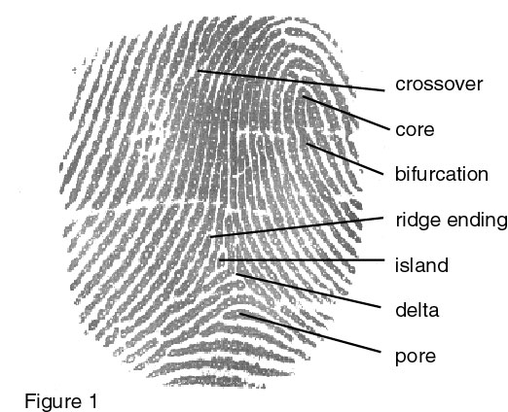
02.
Example of fingerprint
"Fingerprint authentication describes the process of obtaining a digital representation of a fingerprint and comparing it to a stored digital version of a fingerprint.”
Notes:
What is biometrics

Slide 14
02.
Assemble systems
Classifier 1
Classifier 2
Classifier 3
Yes
Score₁ > t₁
No
Yes
Score₂ > t₂
Score₂ > t₂
Score₂ > t₂
No
Yes
Score₂ > t₂
No
False
Yes
Score₃ > t₃
Score₃ > t₃
No
False
True
False
True
Notes:
What is biometrics

Slide 15
PART 03
Pros & Cons
Speaker: Nguyễn Sơn Tùng

Slide 16
03.
Pros
High security and assurance
User Experience
No one indebted for others,while many people don't know how to cherish others.No one indebted for others,while many people don't know how to cherish others.
No one indebted for others,while many people don't know how to cherish others.No one indebted for others,while many people don't know how to cherish others.
01
02
03
04
Non-transferrable
Spoof-proof
No one indebted for others,while many people don't know how to cherish others.No one indebted for others,while many people don't know how to cherish others.
No one indebted for others,while many people don't know how to cherish others.No one indebted for others,while many people don't know how to cherish others.
Notes:
https://www.miteksystems.com/blog/advantages-and-disadvantages-of-biometrics
Humans have lousy memories. A recent report looked at over 1.4 billion stolen passwords and found that most were embarrassingly simple. Among the worst are “111111,” “123456,” “123456789,” “qwerty,” and “password.” While these are easy to remember, any decent hacker could crack these simple passwords in no time.
Too many accounts: As users get more comfortable with doing everything online, they open more and more accounts. This eventually creates too many passwords to remember and paves the way for a dangerous habit: password recycling. Here’s why hackers love this trend: it takes just seconds for hacking software to test thousands of stolen sign-in credentials against popular online banks and shopping sites. If a username and password pair is recycled, it’s extremely likely it’ll unlock plenty of other lucrative accounts.
Security fatigue sets in: To protect themselves, some consumers try to make it harder for attackers by creating more complex passwords and passphrases. But with so many data breaches flooding the dark web with user information, many just give up and fall back to using weak passwords across multiple accounts.
High security and assurance – Biometric identification provides the answers to “something a person has and is” and helps verify identity
User Experience – Convenient and fast
Non-transferrable – Everyone has access to a unique set of biometrics
Spoof-proof – Biometrics are hard to fake or steal

Slide 17
03.
Cons
Costs
Data breaches
No one indebted for others,while many people don't know how to cherish others.No one indebted for others,while many people don't know how to cherish others.
No one indebted for others,while many people don't know how to cherish others.No one indebted for others,while many people don't know how to cherish others.
01
02
03
04
Tracking and data
Bias - Inaccuracy
No one indebted for others,while many people don't know how to cherish others.No one indebted for others,while many people don't know how to cherish others.
No one indebted for others,while many people don't know how to cherish others.No one indebted for others,while many people don't know how to cherish others.
Notes:
Costs – Significant investment needed in biometrics for security
Data breaches – Biometric databases can still be hacked
Tracking and data – Biometric devices like facial recognition systems can limit privacy for users
Bias – Machine learning and algorithms must be very advanced to minimize biometric demographic bias
False positives and inaccuracy – False rejects and false accepts can still occur preventing select users from accessing systems

Slide 18
03.
Downside example
A biometric verification system makes two types of errors:
Mistaking Biometric Measurements From Two Different Persons to be From The Same Person (Called False Positive)
Mistaking Two Biometric Measurements From The Same Person to be From Two Different Persons (Called False Negative)
Notes:
What is biometrics

Slide 19
PART 04
Real world applications
Speaker: Trần Thanh Dương
Notes:
https://www.nec.co.nz/market-leadership/publications-media/the-top-9-common-uses-of-biometrics-in-everyday-life/

Slide 20
04.
Examples
The application of biometric can be divided into five main groups: forensic, government, commercial, health-care and travelling and immigration.
Commercial ATM, credit card, cellular phone, distance learning, etc.
Government ID card, driver’s license, social security, passport control, etc.
Forensic terrorist identification, missing children, etc.
Heath-Care Access to medical details, Patient Info, etc.
Travelling and Immigration Air Travel, Boarder Crossing, Passport, etc.
Notes:
What is biometrics

Slide 21
04.
Formulate
Describing the verification problem:
An input feature vector: X_{Q}
A claimed identity: I
The biometric template corresponding to I : X_{I}
The similarity between X_{Q} and X_{I}: S(X_{Q}, X_{I})
The predefined threshold of similarity: t
True (a genuine user): ω₁ ; False (an imposter): ω₂
Notes:
What is biometrics

Slide 22
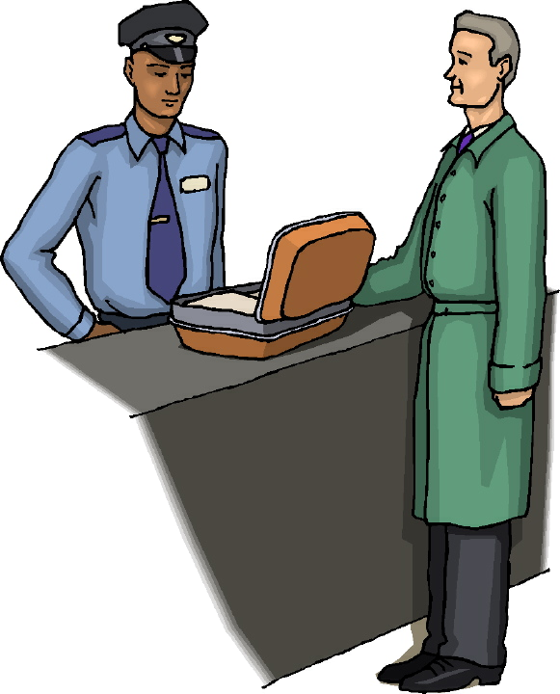
04.
Example - Face Recognition in Airport
Image is sent to
computer
for manipulation.
Hi I am
Dr. Larry Bliss
Image is passed to database
for possible match
Notes:
What is biometrics

Slide 23
Thank You

